Slide 1

AGILE METHODOLOGY
BY:-
SHRADHA ROY
SAYAN DATTA
ARNAB PRATIHAR
DEBOJYOTI BASU
ROCHITA BAGCHI

Slide 2
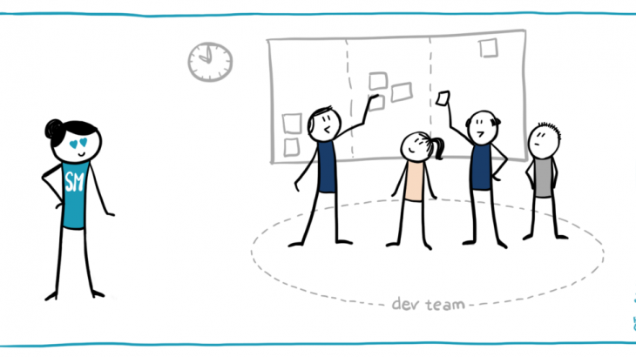
SCRUM
+ Scrum is a framework within which people can address complex adaptive problems, while productively and creatively delivering products of the highest possible value.
+ Scrum itself is a simple framework for effective team collaboration on complex products.
-Scrum is not a methodology.
-Scrum implements the scientific method of empiricism.
-Scrum replaces a programmed algorithmic approach with a heuristic one, with respect for people and self-organization to deal with unpredictability and solving complex problems.

Slide 3

The scrum master is not the project leader and is not held accountable for outcomes.
The scrum master is responsible for:
Helping the team to reach consensus for what can be achieved during a specific period of time.
2. Helping the team to reach consensus during the daily scrum. 5. Protecting the team from outside distractions.

Slide 4

3. Helping the team to stay focused and follow the agreed-upon rules for daily scrums. 4. Removing obstacles that are impeding the team's progress.

Slide 5
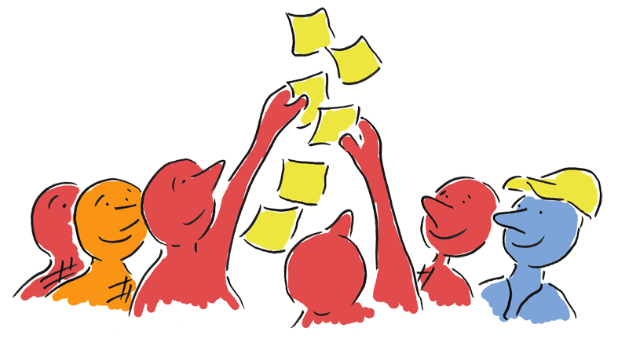
WHAT IS SPRINT PLANNING?
In sprint planning, the entire team agrees to complete a set of product backlog items.
Sprint planning is a time-boxed working session that lasts roughly 1 hour for every week of a sprint.
This agreement defines the sprint backlog and is based on the team’s velocity or capacity and the length of the sprint.

Slide 6
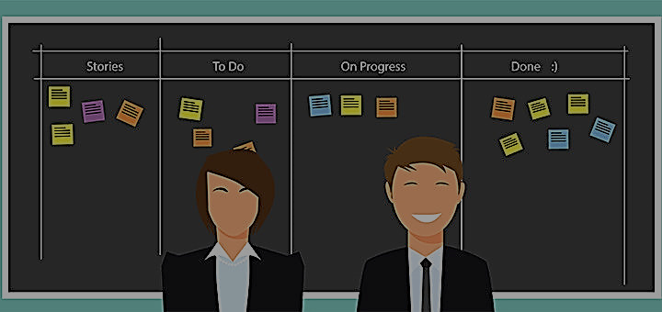
WHO DOES SPRING PLANNING?
Sprint planning is a collaborative effort involving a Scrum Master, who facilitates the meeting, a Product Owner, who clarifies the details of the product backlog items and their respective acceptance criteria, and the Entire Agile Team, who define the work and effort necessary to meet their sprint commitment.

Slide 7
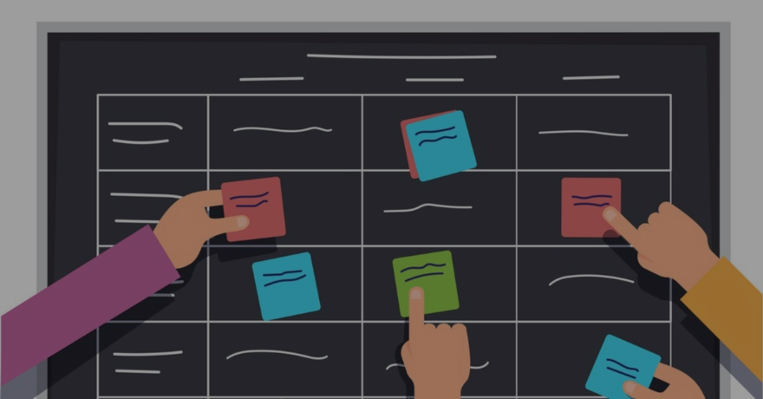
HOW DO WE PREPARE?
Ensure all sprint candidates meet
the team’s
definition of ready.
In the days leading up to sprint planning, the Product Owner identifies the items with the greatest value and works towards getting ready.
+ Assign a relative story point value
+ Create testable examples
+ Remove dependencies
+ Define the acceptance criteria
+ Meet INVEST criteria

Slide 8
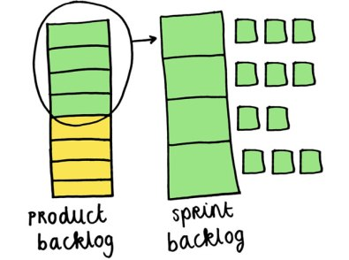
WHAT IS THE BACKLOG?
The product backlog can address just
about
anything, to include
new functionality,
bugs, and risks.
The sprint backlog is a list of tasks
identified by the Scrum team to
be completed during the Scrum sprint.
Product backlog items must be small enough to complete during a sprint and should be small enough to complete within a few days. All stories must be verified that they are implemented to the satisfaction of the Product Owner.

Slide 9
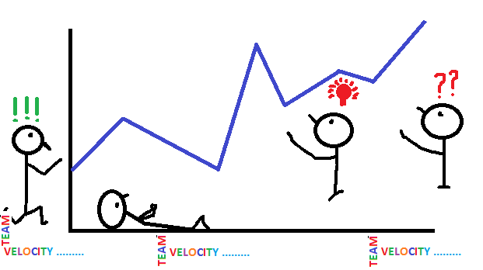
DETERMINING VELOCITY
First of all, as velocity is unique to every team, never use another team’s velocity to plan your sprint. Derive team velocity by summing the story point estimates of all completed and accepted work from the previous sprint.
By tracking team velocity over time, teams will begin to focus less on utilization and consequently more on throughput.

Slide 10

DAILY STANDUP
In Scrum, on each day of a sprint, the team holds a daily scrum meeting called the “daily standup.” Meetings are typically held in the same location and at the same time each day. Ideally, a daily scrum meeting is held in the morning, as it helps set the context for the coming day's work.

Slide 11

POKER PLANNING:-
Most teams will hold a Planning Poker session shortly after an initial product backlog is written. This session (which may be spread over multiple days) is used to create initial estimates useful in scoping the
project.
Planning poker, also called Scrum poker, is a consensus-based, gamified technique for estimating, mostly used to estimate effort or relative size of development goals in software development.

